Slide 1


CACFP / Kids Cafe® Freeze and Thaw Supper Program
Online Training Guide
Sponsor: St. Mary’s Food Bank
Last Updated: 07/2023

Slide 2

What is CACFP At-Risk Afterschool Supper?
A United States Department of Agriculture (USDA) funded program administered by the Arizona Department of Education (ADE) that allows sponsors like St. Mary’s Food Bank Alliance to feed an afterschool meal (supper) to children in low-income areas.

Slide 3
What is Kids Cafe Freeze and Thaw?
This program was designed through a model that doesn’t require daily delivery of meals. We provide sites a 2-week rotating menu of frozen and non-perishable food items that are delivered in bulk once a month.
The Food Bank will provide cases of individual products which are the primary components of a meal along with non-perishable side dishes including shelf-stable milk
The meals will need to be thawed in refrigerator prior to meal service. No cooking or reheating of the meals is required prior to serving.
The site will store the product for up to a month and assemble to create a full meal on-site prior to mealtime.

Slide 4
Sponsor/Agency Partner
Sponsor: operates the CACFP at-risk afterschool supper program. The sponsor communicates with the state agency, Arizona Department of Education (ADE), who administers the nutrition program for the USDA.
    Your Sponsor is: St. Mary’s Food Bank
Agency Partner/Site: places in the community that receive CACFP meals from sponsor for kids to eat in a safe and supervised environment.

Slide 5
Agency Partner Responsibilities
Feed and supervise kids
  Agency Partner must be adequately staffed with an adult to child ratio of 1:20 or 2+ adults for 20+ children
Serve minimum meal numbers - your site may be discontinued if your minimum numbers are not met.
Have a working refrigerator to store meals
Adhere to food safety requirements. At least one staff member must have Food Safety Training
Be able to accommodate a morning delivery
Provide organized, regularly scheduled, in-person, afterschool enrichment activities
  Kids must be enrolled members of the organization with enrollment information on file.
  Agency Partner must track daily attendance of kids participating in afterschool program.
Submit accurate meal counts weekly to Sponsor
Participate in annual training and allow 2 additional monitoring visits per-year

Slide 6

Food Safety – Cold Meals
Cold Meals – meals should be kept in a refrigerator holding at a temperature of 41° degrees or cooler. If your refrigerator exceeds 41° degrees, please call your Child Nutrition Specialist immediately
Meals should only be removed from refrigerator at scheduled meal distribution time.
If there is a problem with a meal
  See procedure for Reporting a Food Safety Issue
    Contact Child Nutrition Specialist immediately
    Isolate any meals identified to be unsafe
    Do not throw away food in question

Slide 7
Reporting a Borrowed Equipment Issue
Contact your Child Nutrition Specialist if borrowed equipment is not working properly.
Be prepared to provide your Child Nutrition Specialist with the following information so a repair technician can be dispatched:
  Description of the problem
    Example: Refrigerator is making a strange noise and holding at a temperature in the danger zone (above 41° degrees).
  Contact name and phone number
  Hours of operation or best time to service equipment

Slide 8

Temperature Logs
Refrigerator temperature should be checked and logged each day.
  Record the temperature on your meal count form
  Use an internal thermometer inside of the refrigerator
  The external thermometers are not as reliable
  Refrigerators should read 41°F or cooler
  Freezers should read 0°F or cooler
Child Nutrition Specialist should be notified immediately if temperatures are reading higher than required.

Slide 9
Meal Ordering
Order – Your Child Nutrition Specialist will take care of your orders. Product will be packed and sent in bulk.
  Each site’s order may take two weeks to create, order, pull product, pack, transfer and deliver to site location.
Delivery – Site can receive once or twice a month deliveries. Delivery factors include number of kids served, size of order and/or geographic location.
Meal number changes
  Changes to meal orders including cancellations must be made directly with your Child Nutrition Specialist.
  Please let site specialist know meal number changes right away, as orders take two weeks to process
  Kids Cafe® produces your meals from purchased product.
    Evaluate the numbers of meals distributed regularly and reduce meals if you have consistent leftovers

Slide 10
Meal Service
Kids Cafe meals funded through CACFP, are for afterschool use. You can serve these meals as soon as your school/or nearest feeder school releases for the school day. Meals cannot be used for lunch
  You must report your scheduled mealtime to your Child Nutrition Program Specialist for monitoring
  Notify your Child Nutrition Specialist if feeding time change throughout the year, so we can update our records with ADE
Any enrolled member of your program, age 18 and under, is eligible to receive a meal
Meals must be consumed on site.
  Meals can be consumed indoors or outside (weather permitting)
  Kids cannot be required to pray in order to receive food
Every child must be served a complete meal (including milk)
A current menu and Civil Rights compliance material must be on display at all times.
Meals counts must be taken at point of service

Slide 11
Meal Production Process
The important part is that all meal components are assembled and readily available for the kids.
Each day:
  Pull intended number of main components/ entrees needed from the freezer for the next meal service day and place in refrigerator. You are thawing these meals in advance. Please cross reference your Kids Cafe menu.
  Do this for each day so that there is enough thawed main component/ Entrees for the next serving day.
A complete meal will have the following items:
    Main component/entrée
    One fruit & One vegetable
    Shelf stable milk
    Condiments and utensils

Slide 12
Leftovers
Leftover entrees should be placed in the freezer after meal service
  These items should be used first when removing items from the freezer for subsequent days
  All leftover inventory should be used before opening new product (First In First Out)
  Leftover product can only be frozen one time
Call your Child Nutrition Specialist if leftovers are consistent to decrease meal numbers and keep waste to a minimum
Share Table - .Allow your program participants to place whatever components they don’t want for others to use. May place unused in inventory.

Slide 13
Meal Count Forms - What is required?
St. Mary’s Food Bank will claim reimbursement for meals distributed to Kids during your meal service. In order for us to claim reimbursement we need the meal count form as documentation to support the claim.
We have created two meal count forms to track meals
Daily meal count form - Designed to track meals for sites serving over 60 kids
Weekly Classroom meal count form - Designed to track meals for sites serving in multiple classrooms
You may select the meal count form that works best for your meal distribution model. You don’t have to use both
If you are distributing a snack, the distributed number also has to be recorded on the meal count form

Slide 14
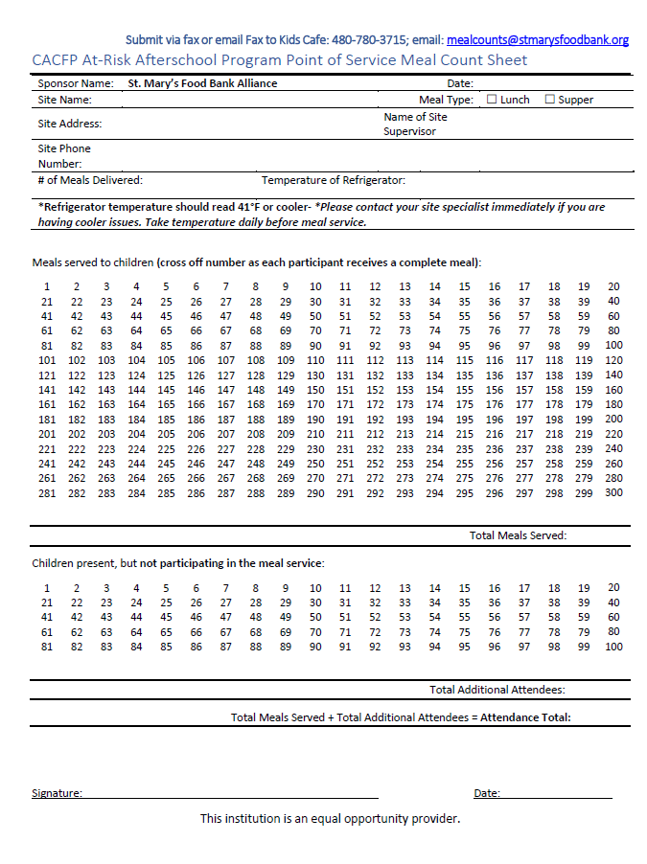
Meal Count Forms - Daily
Meal Count Form must include:
Name of your organization/site name
Date of meal service
Temperature of the meals
Individual handwritten tally mark, at point of service, for each complete meal served to a child
The total number of meals served
The total number of additional attendees (kids that did not eat)
Signature/date affirming form is accurate and was completed in compliance with Federal and State regulations

Slide 15
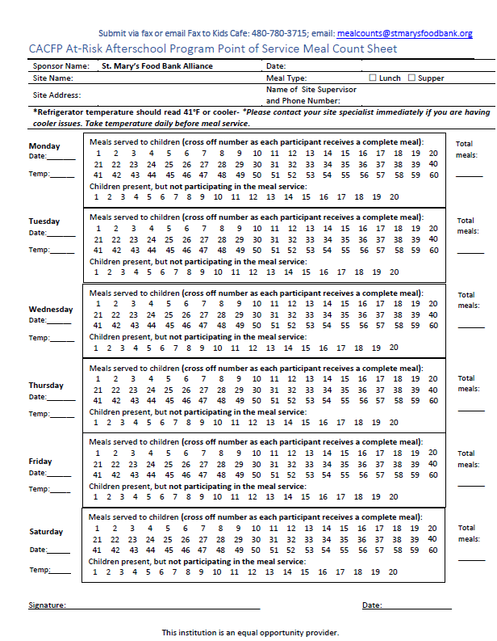
Meal Count Forms - Weekly
Meal Count Form must include:
Name of your organization/ site name
Date of meal service
Temperature of the meals
Individual handwritten tally mark, at point of service, for each complete meal served to a child
The total number of meals served
The total number of additional attendees (kids that did not eat)
Signature/date affirming form is accurate and was completed in compliance with Federal and State regulations

Slide 16
Point of Service Meal Counting
In order to be compliant with the program, you must adhere to the proper meal counting and distribution method.
Meal Counts must be marked off at the point of service
Counting the number of meals distributed after meal service is over or several days later is not allowed!
You MUST count distributed meals during meal service on the meal count roster provided, unless an alternative form has been pre-approved by your Child Nutrition Specialist or Program Manager
Serving second meals to children is not encouraged

Slide 17
Block Claiming
  Block claiming is when a site reports serving the same exact number of meals to the same children every day, with no variation
    Block claiming is now allowed
    Avoid block claiming by tallying meal counts at the Point of Service
  If block claiming is suspected, a meal count audit will be performed by a member of the Child Nutrition team
  If block claiming is confirmed, your site will be placed on corrective action
    Corrective Action includes, but is not limited to, filling out a mandatory weekly consolidated meal count sheet and/or meal count roster
  If block claiming persist, further action may be taken including probation or inactivation of the program at the agency partner site

Slide 18
Meal Count Form Quality
Use a dark blue or black pen to make sure electronic submission can be read.
Clearly write the name of your site and dates of service on the meal count form.
Before submitting meal counts check scan or fax to make sure all pages are attached and whole form can be seen.
Before scanning or faxing please make sure all meal count forms are signed.
If we catch errors or omissions in meal documentation, we will send meal count back for corrections. Please send corrections to us as soon as possible.

Slide 19
Meal Count Submission
Submit meal counts on Monday by close of business for the previous week
  Delivery Options:
    Fax to (480) 780 3715
    Email to mealcounts@stmarysfoodbank.org or
    Take a picture and send by email or text message to your Child Nutrition Program Specialist
Meal counts must be dated, have your site/school name, and be signed.
All original meal counts must be kept on-site for 90 days or sent to St. Mary’s Food Bank Alliance - Child Nutrition Office.
Failure to submit meals counts will result in an interruption in service or suspension. You will be notified if your meal counts are delinquent prior to order cancellation

Slide 20
Required Signs
Agency Partners are required to have the following posters displayed in meal service area
  “And Justice for All”
  “Building for the Future”
  “Procedures for Complaints of Discrimination”
  Current Menu
Agency Partners are also expected to maintain:
  All meal counts for 3 months
  Temperature log on meal count form
  Required Kids Cafe signs, menus and compliance material can be found on our website
Click here to find Kids Cafe compliance material!
Click here for the Freeze and Thaw Menu!
Password: foodbankagency123

Slide 21
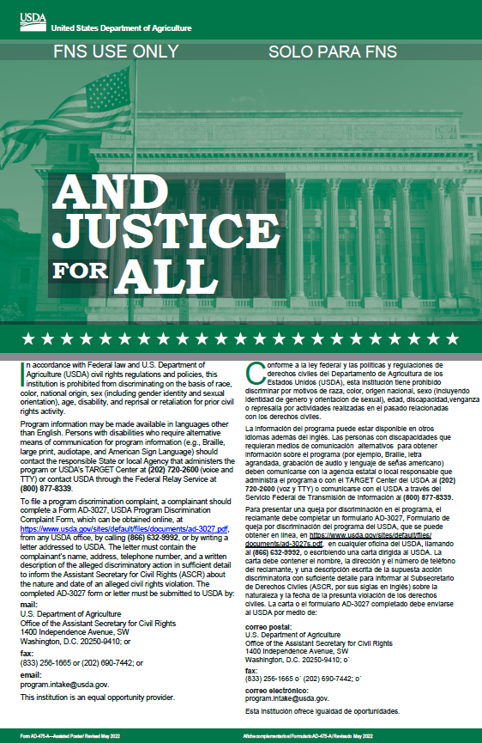
Civil Rights & Non-Discrimination
Meals must be provided to all eligible children regardless of race, color, national origin, sex, age, or handicap.
“And Justice For All” poster must be posted in meal service area
Parents/Guardians have the right to file a civil rights complaint
  Agency Partner Staff should be able to direct them to the information required to make a complaint. Instructions are included on your mandatory civil rights posters.
  If a child/family is requesting information in another language – please contact your Child Nutrition Specialist for assistance in obtaining the materials in the appropriate language.
  Record these on your “Complaints of
  Discrimination” log and contact your Child Nutrition Specialist right away if a family files a complaint

Slide 22
Agency Partner Monitoring Visits
Sponsors are required to make periodic, monitoring visits to the agency partner
  During these visits Child Nutrition Specialist will check:
    Point of Service meal counts
    Temperature Log
    Excess waste/over ordering of meals
    Refrigerator and environment are clean
    Meals are consumed on site
    Meals are served during the designated meal service time
    Only enrolled children 18 years and younger are receiving meals
    Complete meals (including milk) are served
    Agency partner is adhering to the Civil Rights requirements
    All required signs are posted

Slide 23
Monitoring Visits Continued
The Arizona Department of Education and United States Department of Agriculture have the authority to conduct unannounced site visits
  The monitor will introduce themselves and show identification
  Please notify your Site Specialist at St. Mary’s if you receive a monitoring visit from ADE or the USDA.
In-person site visits are required by your sponsor, if you have special protocols for visitors, please let your site specialist know.

Slide 24
Corrective Action
Corrective Action may be necessary to address issues that aren’t in compliance with the program.
Any issues needing to be addressed will be communicated in writing within seven business days.
Sites must abide by the policies, procedures, and record keeping requirements of SMFBA and correct the needed deficiencies to bring site into compliance
Termination & Grievance Policy will be enacted if deficiencies are not corrected

Slide 25
Next Steps:
  Complete Enrollment Packet
  Submit Activity Schedule
  Complete Food Safety Training, if needed
  All partners that are not schools operating NSLP, will need to submit Fire and Health Inspections.

Slide 26

Contact Us
Child Nutrition Program Specialist
Cheyann Pham
  cpham@stmarysfoodbank.org
  Direct: 602-343-2529
  Cell: 480-272-4317
Thank you for your partnership!
Program Manager
Terra Masias
  tlmasias@stmarysfoodbank.org
  Direct: 602-343-3124
  Cell: 602-695-5925

Slide 27
In accordance with federal civil rights law and U.S. Department of Agriculture (USDA) civil rights regulations and policies, this institution is prohibited from discriminating on the basis of race, color, national origin, sex (including gender identity and sexual orientation), disability, age, or reprisal or retaliation for prior civil rights activity.
Program information may be made available in languages other than English. Persons with disabilities who require alternative means of communication to obtain program information (e.g., Braille, large print, audiotape, American Sign Language), should contact the responsible state or local agency that administers the program or USDA’s TARGET Center at (202) 720-2600 (voice and TTY) or contact USDA through the Federal Relay Service at (800) 877-8339.
To file a program discrimination complaint, a Complainant should complete a Form AD-3027, USDA Program Discrimination Complaint Form which can be obtained online at: https://www.usda.gov/sites/default/files/documents/USDA-OASCR%20P-Complaint-Form-0508-0002-508-11-28-17Fax2Mail.pdf, from any USDA office, by calling (866) 632-9992, or by writing a letter addressed to USDA. The letter must contain the complainant’s name, address, telephone number, and a written description of the alleged discriminatory action in sufficient detail to inform the Assistant Secretary for Civil Rights (ASCR) about the nature and date of an alleged civil rights violation. The completed AD-3027 form or letter must be submitted to USDA by:
mail: U.S. Department of Agriculture Office of the Assistant Secretary for Civil Rights 1400 Independence Avenue, SW Washington, D.C. 20250-9410;
fax: (202) 690-7442; or
email: program.intake@usda.gov
This institution is an equal opportunity provider.

