Slide 1
Summer Feeding
2023 Training Guide SFSP
Sponsor: St. Mary’s Food Bank Alliance
Updated 3/28/2023

Slide 2
What is the Summer Food Service Program (SFSP)?
A USDA funded program that allows children/youth to eat free meals at approved locations during the summer months
For the last two summers, we were operating under pandemic waivers which allowed all locations to be eligible and meals could be taken home. These rules have expired, and we are now back to pre-pandemic regulations where meals must be consumed on site.
Host sites must be in an area eligible for service (over 50% of children in the area qualify for Free & Reduced-Price Lunch)
If the site is area eligible, children do not need to provide information or enrollment – anyone 18 and under is automatically eligible to receive free summer meals.

Slide 3
Sponsor / Site
Sponsor: The Sponsor operates the Summer Food Service Program and communicates with the administrative state agency, Arizona Department of Education (ADE)
Your Sponsor is: St. Mary’s Food Bank Alliance
Site: A Site works with their Sponsor to receive a delivery of meals and provides a safe and supervised environment for children to eat. Sites might include:
Schools, community centers, libraries, healthcare offices, churches, apartment complexes, or other locations where kids congregate.
USDA
Arizona Department of Education
The Sponsor: St. Mary’s Food Bank Alliance
Meal Sites: All summer sites operating under our partnership

Slide 4
Site Responsibilities
Offer space to host a meal service
Arrange staff or volunteers to lead meal services at designated days and times
Serve at least 20 meals, 3 times per week (Monday – Sunday)
Conduct outreach to inform families, and host activities to make meal service comfortable and engaging
Provide or borrow a refrigerator from SMFBA to keep food cold on site
Adhere to food safety requirements
Submit accurate paperwork and agreements in a timely manner
Remain in communication with your contact at St. Mary’s Food Bank, and be amenable to monitoring visits

Slide 5
Staffing
Provide adequate staff and/or volunteers to:
Receive meal delivery and verify the number of meals received
Ensure food safety practices are upheld
Distribute meals and supervise meal service
Complete Paperwork
Meal count tracking form
Field Trip forms (if applicable)
Staff ratio should be 1 adult to 20 children

Slide 6
Meal Type and Time
Meals are individually packaged and do not require food preparation on site
During the summer, St. Mary’s Food Bank can provide lunch or dinner meals for children
Breakfast is available only for pre-approved sites with a structured summer program with enrolled kids on-site daily.
All breakfast meals will be delivered to Kids Cafe partners the day before meal service to ensure they are there in time for your meal service.
Lunch and supper will vary depending on your location, start date and amount ordered. Your site specialist will explain the delivery model to you in detail, prior to your start date.
Mealtime should be consistent throughout the summer
Meal service may last from 30 minutes to several hours
Meal service should be limited only to the amount of time that staff and/or volunteers are able to dedicate to serving meals and supervising children
Meal service may also be limited based on food safety (the length of time food can be safely held on site)
Meals and meal types may only be served during designated hours (i.e. when breakfast hours end, breakfast service cannot continue, lunch must be served instead)

Slide 7
Meal Pattern
The USDA is very specific on meal patterns and what meals are eligible during SFSP. As a summer feeding partner, you can expect Kids Cafe meals to meet these requirements.
Components | Breakfast | Lunch & Supper
Fluid Milk | 1 cup (8 fl. oz) white milk only | 1 cup (8 fl. oz) Chocolate milk allowed!
Grains and Breads (Whole grain) | 1 serving | 1 serving
Meal or Meat Alternative | Optional | 1 serving
Vegetable and/or Fruit | ½ cup (4 fl oz.) | ¾ cup serving

Slide 8
Meal Ordering
Meal Service supervisors at your site are responsible for making sure an appropriate number of meals are ordered.
Changes to meal orders must be made directly with your Site Specialist by phone or email
Please order only enough food for each child to receive one complete meal. Consider that not all children attend every day.
Notify your Site Specialist at least 48 hours ahead of your meal service if you need to change or cancel your order. Allow 48 hours for all order changes to take effect.

Slide 9
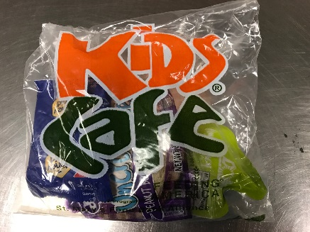
Meal Service
All meals must be consumed on site.
Only a fruit or vegetable or grain may be taken home. Keep in mind that only ONE of these can be taken home, not all three
Meals can be consumed indoors or outdoors (weather permitting)
Anyone 18 years and younger can receive a meal, this includes meals to the public and not just enrolled program participants
Every child must be served a complete meal with all components provided, including milk
Meal counts must be taken at the point of service
+
=
A Complete Meal!

Slide 10
Point of Service Meal Counting
Meal counts must be recorded at the time the child receives their meal
One meal per child, second meals are not recommended
If there is enough for seconds, please request a reduction to your meal order
A separate meal count sheet is needed if you are serving Breakfast and Lunch/Supper everyday
Dates and meal type should be clearly selected on the meal count form.
We will claim a reimbursement for each meal served to each child for the different meal services
Site Leaders cannot go back and fill out forms after meal service is complete

Slide 11
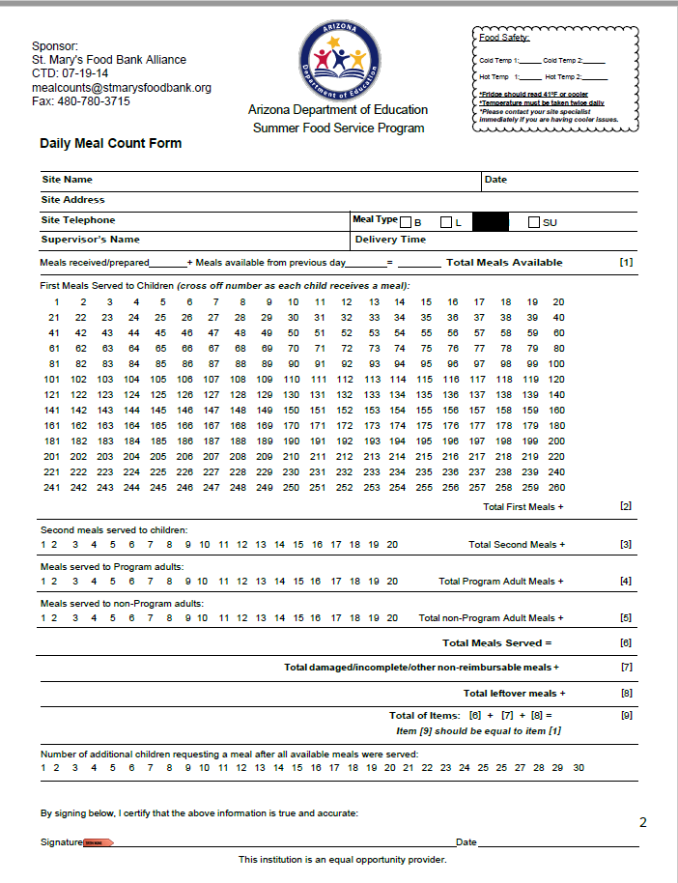
Daily Meal Count Form
Each day your site will track meal counts on a daily meal count form.
Weekly meal counts must be discontinued if you were using them for the school year.
Meal counts should include:
Name of your site
Number of meals delivered
Total number of first meals served
Temperature log for day
Signature of staff or supervisor acknowledging the form has been filled out consistent with program requirements.
If meals count forms are incomplete or unsatisfactory, they may be returned to your site for correction.
Please use dark ink to ensure high quality meal count submissions

Slide 12
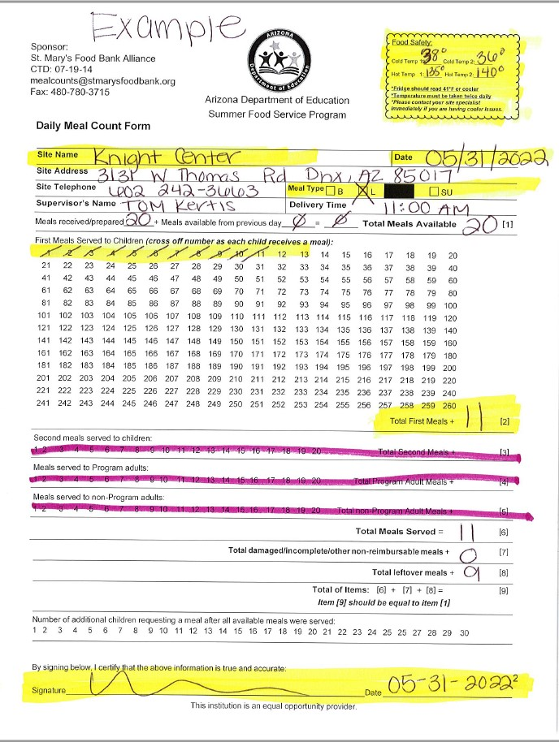
Daily Meal Count Form - Example
Here is a completed meal count form notice:
Temperature of equipment used to store meals is clearly logged
Meal count form has site name, date meals were served and the total number of meals available is filled out.
First meals served to children is tallied on meal count form individually.
Total Number of first meals is written in box #2
Meal service supervisor has signed and dated the meal count form.

Slide 13
Things you can do to improve Meal Count Quality
Use a dark blue or black pen to make sure electronic submission can be read.
Clearly write the name of your site and dates of service on the meal count form.
Before sending meal counts check scan or fax to make sure all pages are attached and whole form can be seen.
Before scanning or faxing please make sure all meal count forms are signed.
If we catch errors or omissions in meal documentation, we will send meal count back for corrections. Please send corrections to us as soon as possible.

Slide 14
Block and Fraudulent Claiming
Block claiming is when the same number of meals are distributed everyday to the same children with no variation.
Block Claiming is not allowed
Block claiming also indicates that Point of Service meal counts may not be occurring, and forms are filled out hours or days after meal service is complete.
If block claiming is suspected a monitoring visit/audit of meal counts will be conducted by a member of the Child Nutrition Team. This monitoring visit will occur within 30 business days of the finding.
If a block claim is confirmed, further action may be taken including probation or inactivation of the program at the partner agency site

Slide 15
Red Flags for Block Claiming
Over claiming
Site is claiming more meals than they are receiving.
Point of Service method not used
Meal count forms are submitted with errors, such as the meals are not tallied individually.
Number of meals claimed is equal to the number of meals delivered without variation for 15 or more days.
Waste
Waste report shows leftover meals are being sent back, but meal count reflects all meals were distributed.
Holidays or days off
Site claims meals for days when meals were not ordered or delivered.

Slide 16
Meal Count Submission
Submit meal counts on Monday by close of business for the previous week
Delivery Options:
Fax to 480-780-3715
Email to mealcounts@stmarysfoodbank.org or Take a picture and send by email or text message
Meal counts must have your site name and must be signed and dated
All original meal counts must be kept for the duration of summer. You can send original meal counts to St. Mary’s Food Bank Alliance - Child Nutrition Office
This year you can find all SFSP documents including meal count forms on our webpage: CLICK HERE
Click on Summer Feeding Signs & Resources
Submitting meal counts late may result in suspension of services

Slide 17
Changes to mealtime
Mealtime
Mealtimes can be adjusted as needed.
If serving both breakfast & lunch, one hour must elapse between serving times.
It is important that you only serve meals at the time you have reported to St. Mary’s Food Bank.
Mealtimes are approved and made public on a state database any changes made by site should be reported to us so we can update our records and inform ADE.
Field Trips
To take meals off site for a field trip you must complete a Field Trip Request form.
Your Site Specialist will call to confirm food safety standards will be met when meals are taken off site.
All meal service changes including field trips
must be reported to your Site Specialist with 48 hours notice.

Slide 18
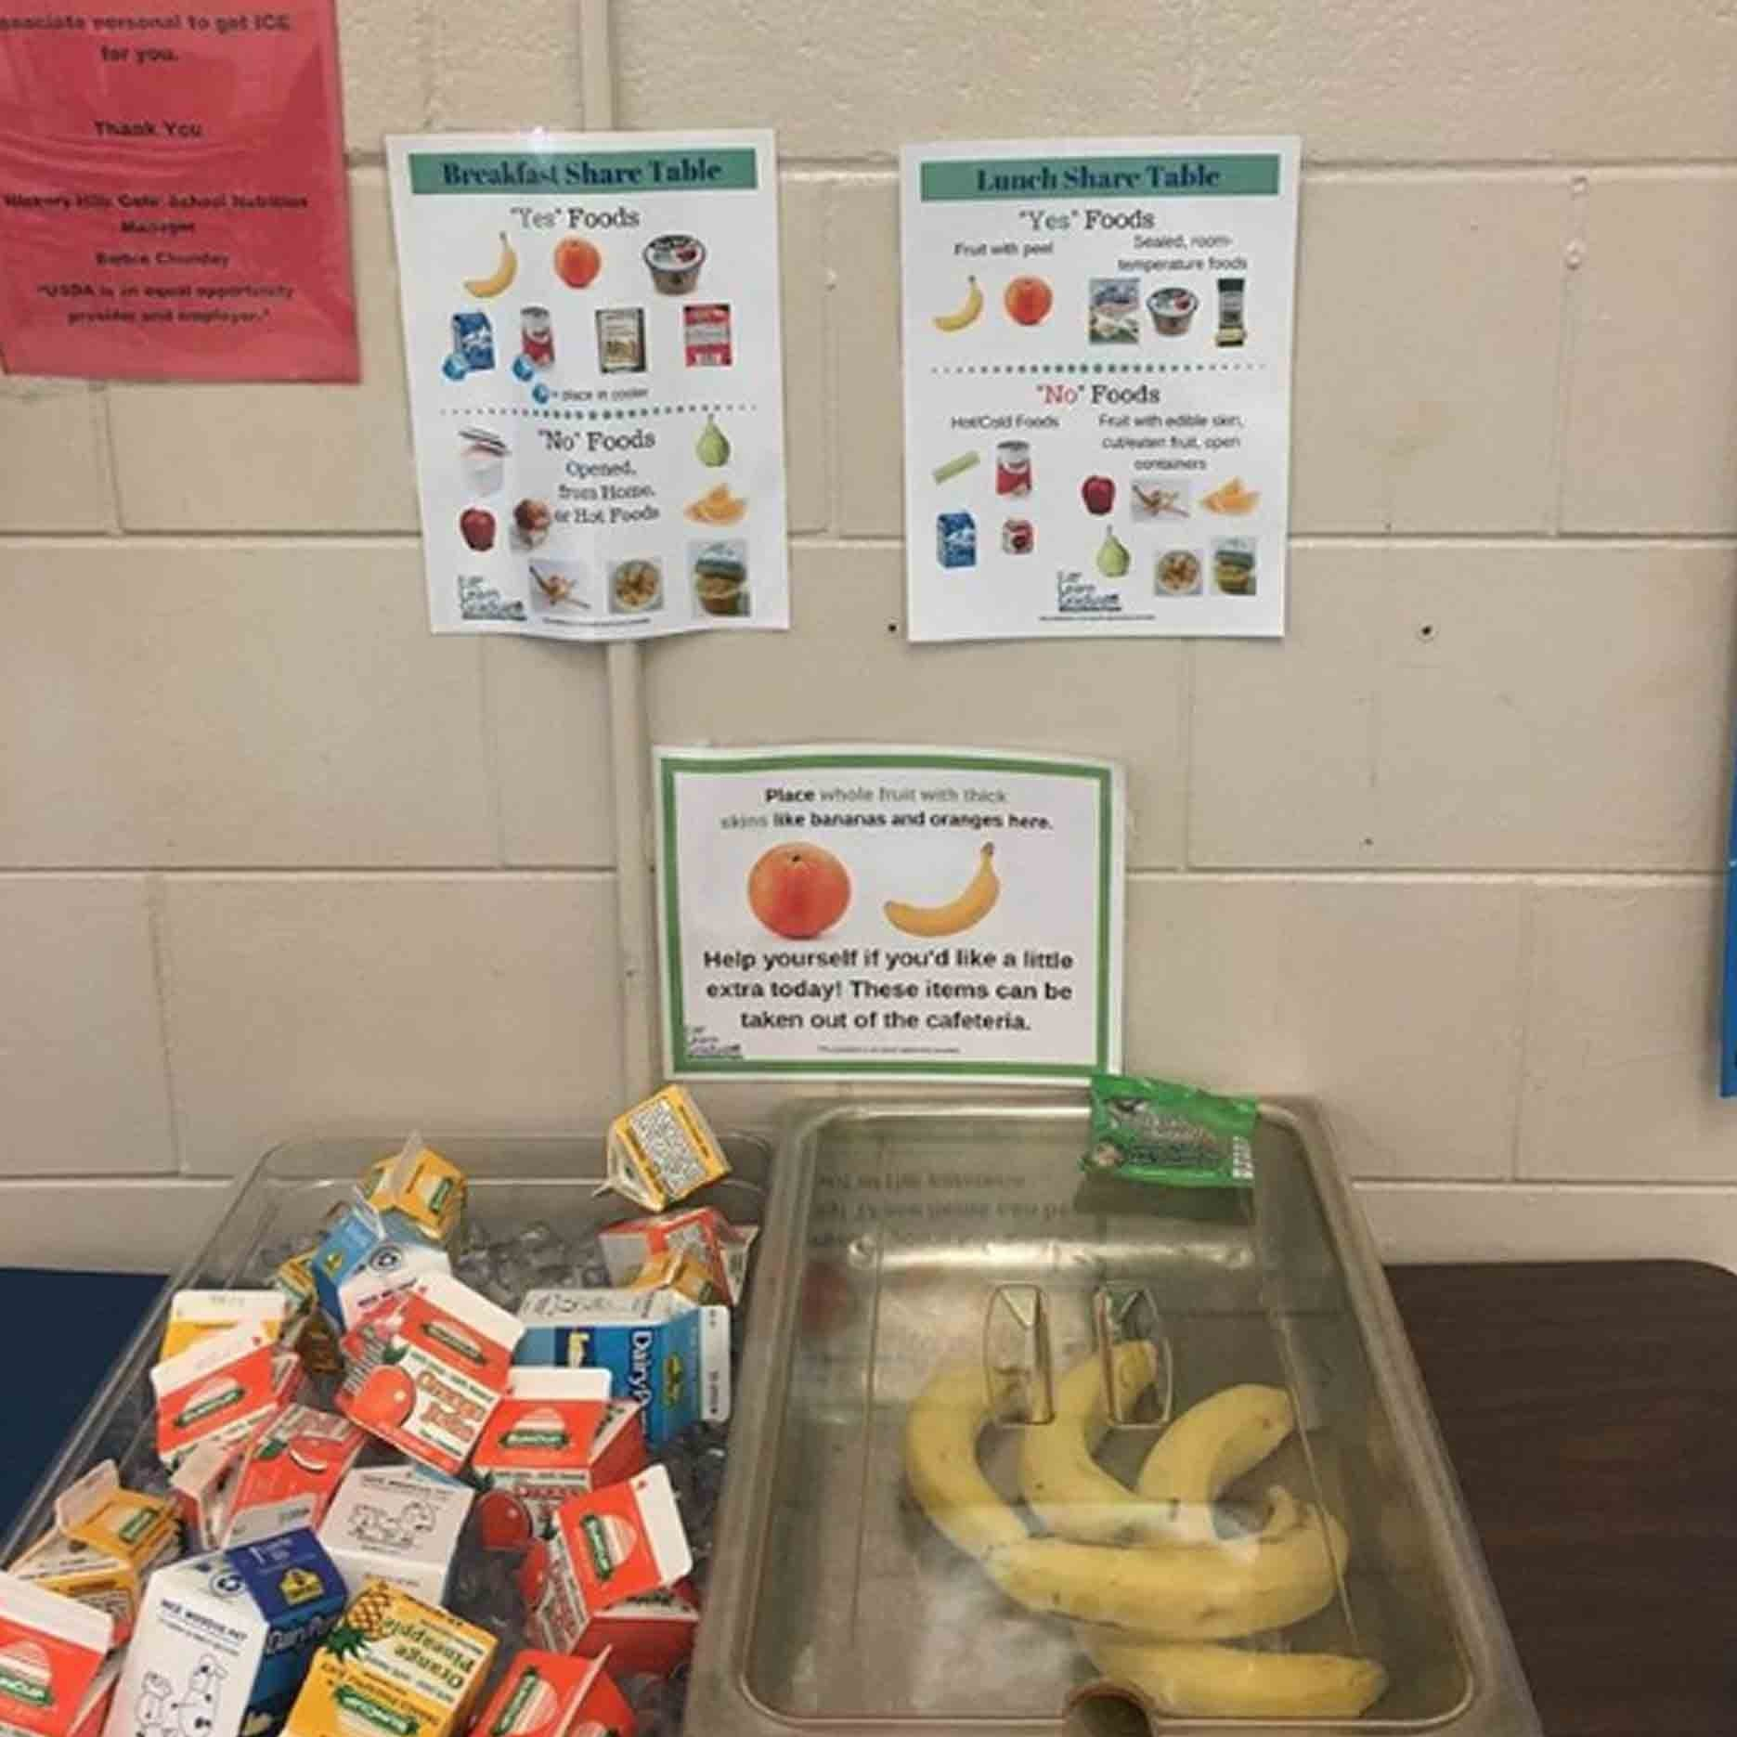
Share Table & Leftovers
If you choose to use a Share Table, items from the Share table cannot be tracked on your meal count form.
Any unopened items that are unwanted should be placed on a Share Table.
All items on the Share Table are available for others to take.
Perishable items and milk should never be left out of cold storage for longer than 1 hour.
Leave unopened refrigerated meals in cooler for the driver to pick up the next day
When the following day is a weekend, holiday, or site closure, the food can be distributed to community.
Hot meals cannot be saved. Please give all leftovers to the community at the end of each day.
Call your Site Specialist to decrease your order if leftovers are consistent.

Slide 19
Mandatory Signs
A current menu must always be on display for each meal type offered by your site
Menus must be posted for families to see, in the area where your meal service takes place
The “And Justice for All” poster must be displayed in a public area
The “Procedures for Complaints for Discrimination” poster must be displayed in a public area
Mandatory signs will be provided to you by your St. Mary’s Child Nutrition Program Specialist

Slide 20
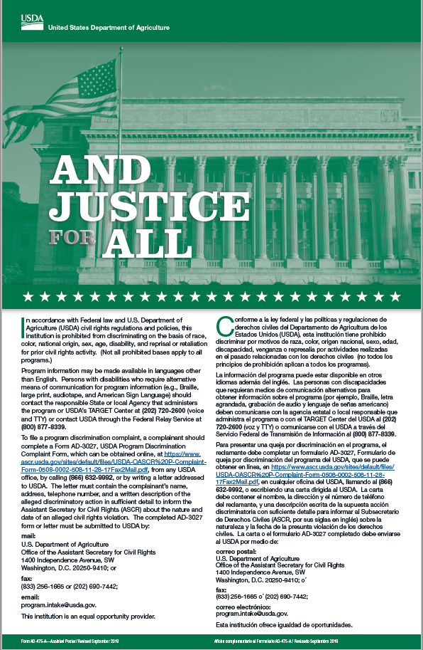
Civil Rights/Non-discrimination
Meals must be provided to all eligible children regardless of race, color, national origin, sex, age, or handicap
The “And Justice For All” poster must be posted in meal service area, informing families of equal access to meal services
If you have questions or concerns about accommodation requests, inform you Child Nutrition Program Specialist
Parents and guardians have the right to file a claim within 180 days of any alleged discrimination
Staff should be able to direct families to information required to file a claim
If a complaint occurs, inform you Child Nutrition Program Specialist
St. Mary’s Food Bank must maintain and log any Civil Rights complaints made by program participants.

Slide 21
Food Safety
Food safety matters to St. Mary’s Food Bank Alliance (SMFBA) and we are committed ensuring our program partners can uphold food safety requirements.
At least one representative from each site must be trained on Food Safety.
The trained representative must be a regular staff member or volunteer who is involved in the daily operations and handling of food.
Your site specialist will send you St. Mary’s Food Safety training. If the current Food Handlers Card is expired, or if there are new staff implementing the Kids Cafe program.

Slide 22
Food Safety- Cold Storage
Cold storage is necessary to hold meals safely at your site.
You may use your own refrigerator if there is sufficient space for meals and milk.
If you don’t have cold storage available, we will lend you equipment for the duration of your program
We will need a signed borrowed equipment agreement
General Storage Guidelines
Store refrigerated foods at 41˚ F or lower.
Sites should log temperature of equipment on meal count form.
Store food in designated food storage areas. Keep pet food and chemicals away from foods for human consumption.
Keep food at least 6 inches off the floor. Never store food on the floor.
Store food 18 inches away from the walls.
Keep ready-to-eat foods above raw meats, seafood, and poultry.
Store food only in containers made for food storage.
Please note: Available equipment may vary.

Slide 23
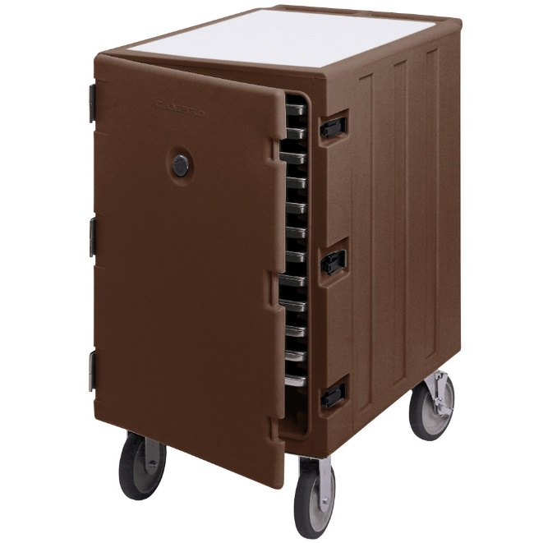
Food Safety – Hot meals & Cambros
The following requirements apply to the limited number of sites receiving hot meals:
Kids Cafe Hot Meals will include both Hot and Cold components, children must receive both.
Cambro units are used to keep hot food at a safe temperature of 135°F or warmer.
If your cambro registers lower than 135°F, is un-plugged for an extended period, or seems to be damaged, contact your St. Mary’s Specialist.
A cambro of meals will be delivered daily and left on site overnight. Sites must ensure the units are stored safely.
Cambros must be plugged in while holding food. They may hold food for up to 4 hours after delivery.
When meal service ends or 4 hours have passed, please give out or safely dispose of any remaining meals.
Hot meal Cambros –Approximate Size 1.5ft x 2ft x 2.5ft WxLxH

Slide 24
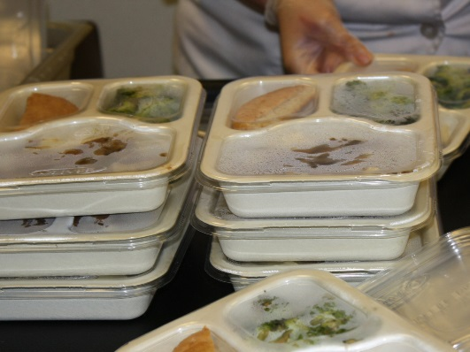
Food Safety- Hot Meals Continued
Meals should only be removed from hot storage at mealtime. Only trained adults may open or move the cambro. Use care when opening the unit as steam may be released.
Leftover hot meals CANNOT be saved.
The cambro unit should be completely emptied and unplugged every night.
Hot meals are offered to a limited number of sites, and only for lunch/supper. Breakfast provided to eligible sites will not be hot.

Slide 25
Food Safety - Temperature Log
Refrigerator temperature should be checked and logged on the meal count form once a day.
41°F or cooler at all times
Hot meal sites must also log temperature of cambro unit
135°F or higher at all times

Slide 26
Reporting a Food Safety Issue
If there is a problem with a meal:
If there is a problem with Equipment:
See procedure for reporting a food safety issue
Contact Site Specialist Immediately
Do NOT throw away food in question– St. Mary’s may pick it up to investigate the source of the issue
Isolate any meals identified to be unsafe, and stop meal service, if needed.
Contact your Child Nutrition Specialist if borrowed equipment is not working properly. Provide your Child Nutrition Specialist with the following information so a repair technician can be dispatched:
Description of the problem
Contact name and phone number
Hours of operation
Take a picture or video of the problem when possible

Slide 27
Food Safety - Main Points
Practice good personal hygiene.
Foods must be prepared and handled in a safe manner.
Ensure the food you receive is stored properly.
Keep thermometers in refrigerators and freezers, and check and log temperature
Ensure preventative pest control is being practiced.
Report Food Safety Questions or Issues to your Site Specialist

Slide 28
Getting Kids to your Summer Feeding Program!
Summer Feeding Banners
Summer feeding flyer
Post in your community:
At Laundromats
On Bulletin Boards
In email blasts
Door to door canvassing
Post information on social media
Consider providing fun activities at your site to attract and engage kids
AZ Health Zone provides SFSP promotional material on their website! Click here! To visit the summer toolkit on our google drive.

Slide 29
Agency Partner Monitoring Visits
St. Mary’s Food Bank staff are required to make periodic, unannounced visits to your site
All Kids Cafe partners will receive a visit within the first four weeks of operation.
New Kids Cafe partners who have not participated in afterschool feeding will also receive a visit within the first two weeks.
The Arizona Department of Education has the authority to conduct unannounced site visits
ADE staff will introduce themselves and show proper identification.
They will sit an observe your whole meal service. They will pay special attention to the following items:
Meal Counting
Make sure meals are consumed onsite
Record keeping
Food Safety
Please notify your Site Specialist if you receive an ADE site visit

Slide 30
Agency Partner Monitoring Visits
Sponsors are required to make periodic, unannounced visits to the agency partner
During these visits Child Nutrition Specialist will check:
Point of Service meal counts
Temperature is logged onto meal count forms
Excess waste/over ordering of meals
Freezer/Refrigerator and environment are clean
Meals are consumed on site
Meals are served during the designated meal service time
Only enrolled children 18 years and younger are receiving meals
Complete meals (including milk) are served
Agency partner is adhering to the Civil Rights requirements
All required signs are posted

Slide 31
Signatures & Forms needed
PowerPoint Training Completion Form, Training Sign-In
Partner Agreement – you are agreeing to partner with us this us this summer and adhere to Kids Café & SFSP Policies
Borrowed Equipment Agreement, if necessary
Background Check Verification Form
You are completing form to verify that your staff and/or volunteers working with minors for the meal service have undergone a background check
Food Safety Certificate, or Food Handlers Card

Slide 32
Contact Us:
Maricopa County Specialists
Cheyann Pham
cpham@stmarysfoodbank.org
Direct: (602) 343-2529
Cell: (623) 866-2637
Annette Martinez:
amartinez@stmarysfoodbank.org
Direct: (602) 343-2526
Cell: (714) 366-2962
Mimi Dinkins
mldinkins@stmarysfoodbank.org
Direct: (602) 343-3109
Cell: (623) 330-1601
Diana Rocha
drocha@stmarysfoodbank.org
Direct: (602) 343-3198
Cell: (956) 822-4011
Northern Arizona - Site Specialist
Cheyann Pham
cpham@stmarysfoodbank.org
Direct: (602) 343-2529
Cell: (623) 866-2637
Program Manager
Terra Masias
tlmasias@stmarysfoodbank.org
Direct: (602) 343-3124
Cell: (602) 695-5925
Thank you for your partnership!
Kids Café Fax Number – (480) 780-3175

Slide 33
In accordance with federal civil rights law and U.S. Department of Agriculture (USDA) civil rights regulations and policies, this institution is prohibited from discriminating on the basis of race, color, national origin, sex (including gender identity and sexual orientation), disability, age, or reprisal or retaliation for prior civil rights activity.
Program information may be made available in languages other than English. Persons with disabilities who require alternative means of communication to obtain program information (e.g., Braille, large print, audiotape, American Sign Language), should contact the responsible state or local agency that administers the program or USDA’s TARGET Center at (202) 720-2600 (voice and TTY) or contact USDA through the Federal Relay Service at (800) 877-8339.
To file a program discrimination complaint, a Complainant should complete a Form AD-3027, USDA Program Discrimination Complaint Form which can be obtained online at: https://www.usda.gov/sites/default/files/documents/USDA-OASCR%20P-Complaint-Form-0508-0002-508-11-28-17Fax2Mail.pdf, from any USDA office, by calling (866) 632-9992, or by writing a letter addressed to USDA. The letter must contain the complainant’s name, address, telephone number, and a written description of the alleged discriminatory action in sufficient detail to inform the Assistant Secretary for Civil Rights (ASCR) about the nature and date of an alleged civil rights violation. The completed AD-3027 form or letter must be submitted to USDA by:
mail: U.S. Department of Agriculture Office of the Assistant Secretary for Civil Rights 1400 Independence Avenue, SW Washington, D.C. 20250-9410;
fax: (202) 690-7442; or
email: program.intake@usda.gov.
This institution is an equal opportunity provider.

