Slide 1

The Backpack Program
St. Mary’s Food Bank Alliance
Training Guide
Last Updated:01/22

Slide 2
What is the Backpack Program?
St. Mary’s Food Bank Alliance works with
Program Partners in the community to provide
non-perishable goods to families who might
miss meals on the weekend.
The Backpack Program can fill a gap
for families who do not have access to
other forms of food assistance.

Slide 3
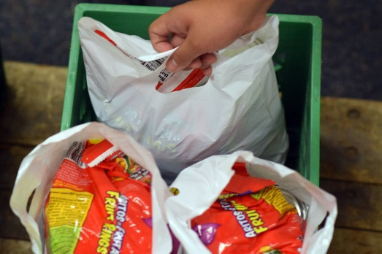
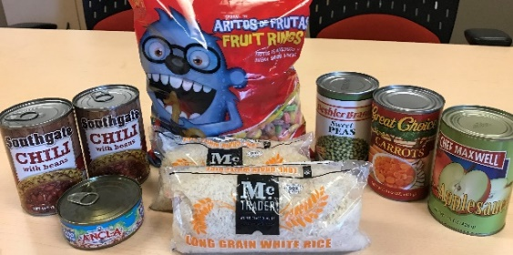
What is a Backpack?
Backpacks are durable, white plastic bags of
non-perishable foods that will supplement
a family’s weekend meals.
Backpacks:
  Weigh about 10lbs and have a value
  of approximately $8 each.
  Contain 9 retail size food items
  (peanut butter, pasta, beans, rice, etc.)
  from four rotating menus.
  May offer families the chance to
  cook and dine together.

Slide 4
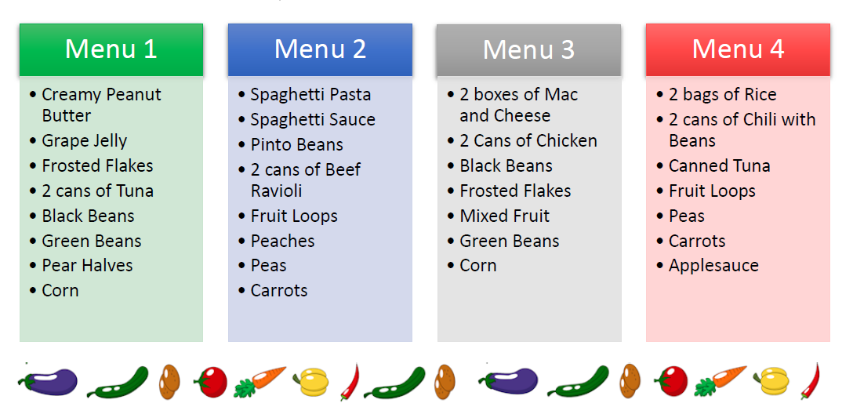
Backpack Menu
Available in English & Spanish

Slide 5

How does the Backpack Program work?
1. St. Mary’s selects program partners
2. Program partners identify families in need of a
weekly backpack
3. St. Mary’s delivers pre-packed backpack bags to
program partners
4. Partners distribute backpacks to children and submit
distribution reports

Slide 6

Create a team to support the
Backpack Program at your site
St. Mary’s Child Nutrition Specialist
Primary and Secondary
Backpack Leaders
at your site
Other staff
Volunteers (parents, community members, or student groups)
Your CN Specialist will:
Offer initial trainings
Conduct check-in visits
Arrange your orders and deliveries
Offer support when needed
Backpack Leaders are responsible for:
Managing inventory
Backpack distribution
Breaking down BP Boxes
Food safety
Reporting
Remaining in close contact with their
St. Mary’s CN Specialist
Time estimate: about 2 hours of work per week
Staff and volunteers may:
Help identify families
in need
Help sort and store product
Assist with distributing backpacks

Slide 7
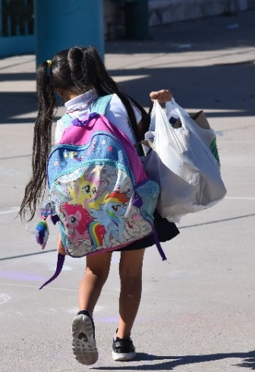
Selecting Children to Receive a Backpack
Eligibility:
Backpacks are intended for
children who are missing meals
on the weekend.
To make enrollment as simple as possible,
school personnel refer students to participate:
  St. Mary’s asks only for the student’s name or initials
  Sites may provide a letter along with the child’s first backpack,
  offering parents/guardians a chance to opt-out of the program.
Backpacks are intended for a family of 4.
Larger families may receive additional bags, if needed.

Slide 8
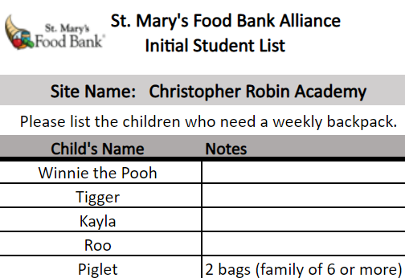
Creating your Student List
Your Student List lets your CN Specialist know how many backpacks you need.
Follow these steps to Create & Adjust your list:
Identify children with need
Ask staff to help refer students in need:
Submit your
Student List
to your
CN Specialist
Submit your list
2 weeks prior to
your start date.
We will send one
weekly backpack for
each child on your list.
Adjust your Student List, as needed
You may add, remove, and
substitute students on your list throughout the year.
Inform your CN Specialist
if you need a change
in your order quantity.
Teachers
Cafeteria Staff
Parent Liaisons
School Nurse

Slide 9
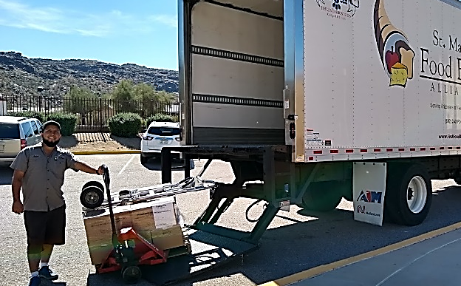
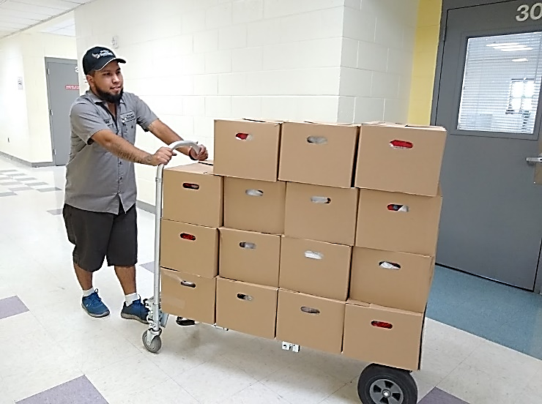
Backpack Deliveries (Part 1 of 2)
Once your Student List is approved, your CN Specialist
will arrange your delivery schedule.
→ In metro Phoenix you may receive a
delivery once per week
→ Outside of metro Phoenix you may receive
a delivery once or twice per month
Receiving a delivery:
Inform appropriate staff (front office/custodians) about the delivery, and where product should go.
Backpacks are delivered on pallets.
  If doorways are less than 4 feet wide, have
  volunteers help unstack and carry in items.
Let us know if roads or paths are not paved or accessible to a semi-truck
Driver bringing about 45 backpacks into a school

Slide 10

Backpack Deliveries (Part 2 of 2)
Upon Arrival:
Inspect all product you receive to ensure:
Food is labeled and does not have: Swollen ends, leaks, seal problems, lids that are popped, major dents, or rust.
The quantity ordered matches the amount received.
Driver will ask for a signature to ensure delivery has been made.
Notify your CN specialist if any contents are damages upon arrival. Please save the item damaged, so we can further investigate the source of damage.
When in doubt, don’t give out!

Slide 11
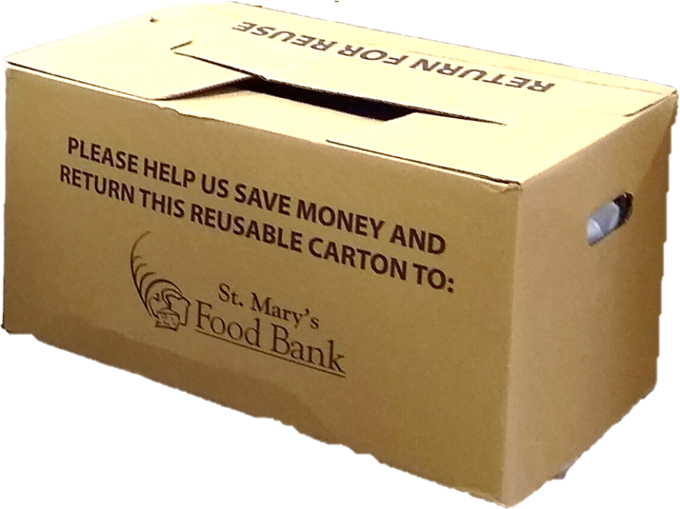
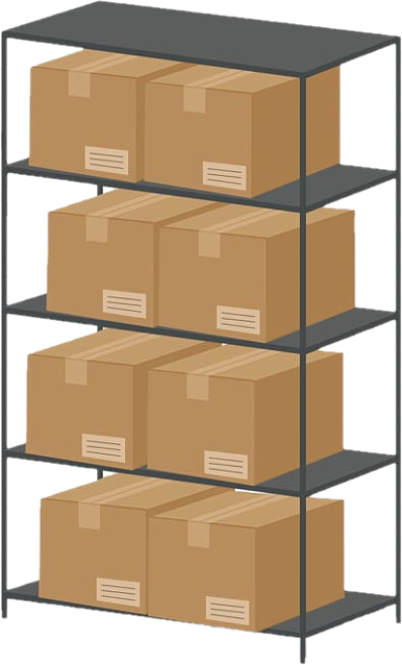


Backpack Storage
Backpacks will arrive in cardboard boxes:
  3 backpack bags are inside each box
  A 4 x 4 ft pallet holds 120 backpacks
Suggested storage areas include:
Storage Requirements:
At room temperature
Secure, clean, dry area
6 in. off the floor and 4 in. from the wall
Enough space to organize and navigate safely
On shelves in a storage closet, empty classroom, or the cafeteria
On pallets, in a warehouse or multi-purpose space

Slide 12
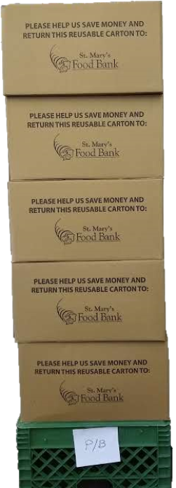
Managing Inventory
If you receive more than 1 week of backpacks
at a time, sort & label boxes by menu type
There are 4 backpack menus, distinguished by: menu 1, 2, 3, and 4 stickers on boxes
Look at boxes to see what number they are labeled with. Separate boxes in your storage area.
Each week you will give out one menu type.
If you have bags leftover, let your CN Specialist know to reduce your next delivery.
If you are a rural site, you are required to complete Link2Feed training to track numbers distributed to help manage inventory levels
When you receive a new delivery, keep your existing inventory in the front so that it is
given out first
12 backpacks in 12 boxes, stacked on a labeled crate

Slide 13


Food Safety
Verify product quality when you receive your delivery, and when you distribute backpacks
If you or families are concerned about any items, set them aside and send a picture to your CN Specialist.
Note: Backpack items are
purchased (not donated)
to ensure quality and consistency.
Each month, inspect your storage area for any signs of pests.
At least 1 person at your site must
have a Food Handler’s card or internal Food Bank Food Safety training
Your CN Specialist can help you fulfill this requirement.

Slide 14
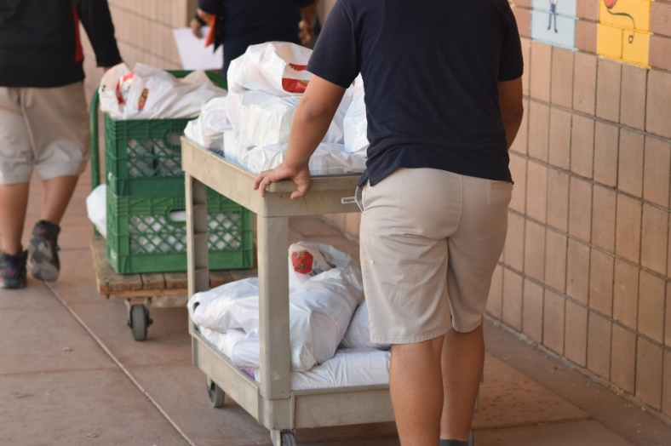
Backpack Distribution
Each child on your Student Backpack List should receive a backpack each week.
Determine a consistent day, time, place, and process for distribution (preferably toward the end of the week)
Suggested processes include:
Delivering to the back of classrooms
Providing to students as they get on the bus
Asking students to pick up at the end of the day
Ask parents, staff, or student groups to assist
Do Not: make identifying announcements, or have children deliver directly to peers
Inform students of a “make-up” policy, in case they are absent.
For example: Students pick up bag on Monday in front office
You may use marker to label make-up bags with student names, if you wish.
If you are doing home deliveries, or parents are coming to pick up bags you may ask your CN Specialist about distributing 2 bags every other week.

Slide 15
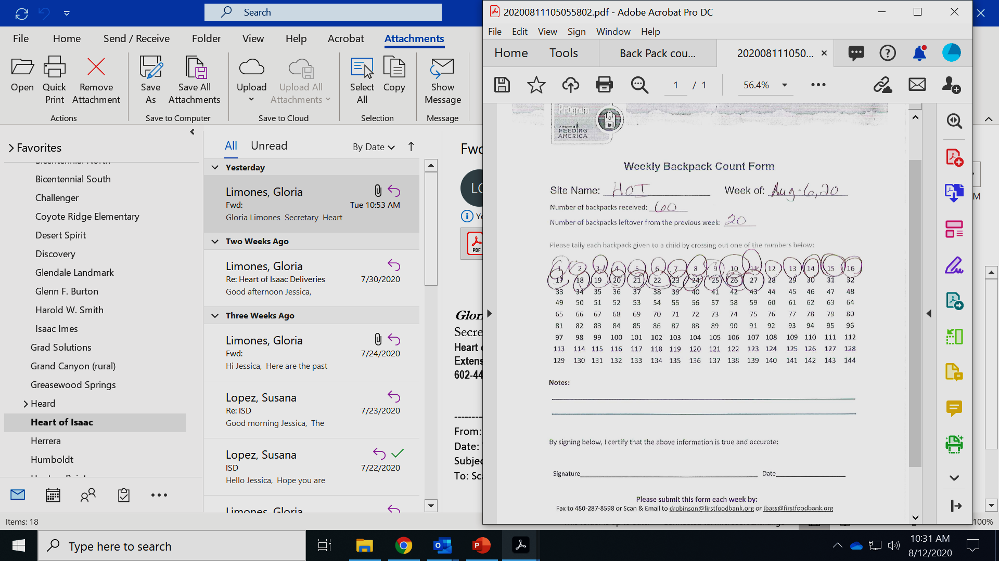
Record Keeping - Weekly Tally
You may use the Weekly Tally Form provided by your CN Specialist and mark off every bag given out, each week.
Or you may use Link2Feed, an electronic tally submission application
Below is an example tally form. Note that:
The site received 60 Backpacks for that week
They had 20 Backpacks still on hand from last week
They gave out 27 bags (this is the number they will record on their online form
The site has extras left over. They need to ask their CN Specialist to decrease their orders.

Slide 16
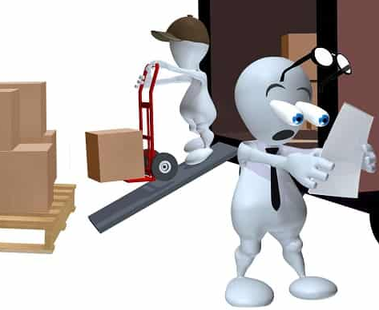
Inventory & Order Changes
We provide exactly the number of backpacks you should need to last you until your next delivery.
**Order in increments of 3
Orders are finalized 2 weeks in advance, and usually cannot be adjusted after this point.
Notify your CN Specialist at least 2 weeks ahead of any holidays or closures that may affect your delivery
or distribution.
If you find you have inventory building up, let us know as soon as possible.
Note: we do not take back extra inventory, but we can cancel future deliveries if given advanced notice.

Slide 17
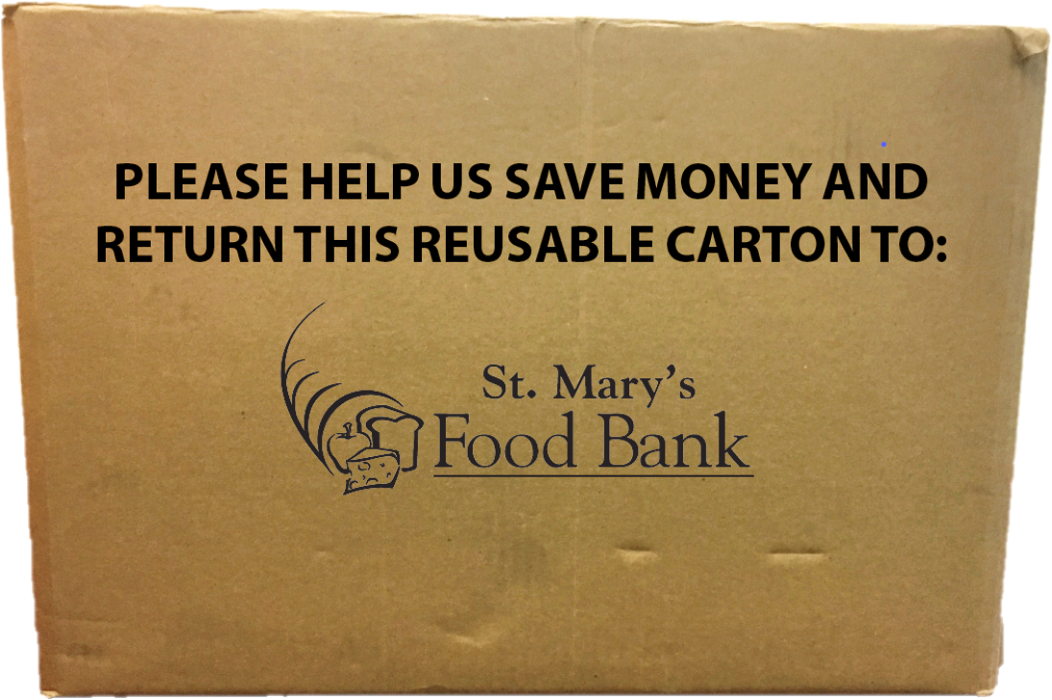
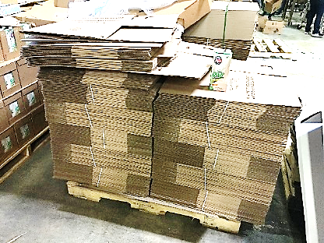
Backpack Boxes
Please break down and save the cardboard boxes
that hold backpack bags
A St. Mary’s driver will pick up any boxes and pallets
at your next delivery.
  Keep boxes stacked neatly off the floor and away from moisture.
  You may put a note by them so they aren’t taken/thrown away
← The label on a
box of backpacks
Flattened boxes, →
neatly stacked
on a pallet
For a quick video on how to break down a backpack box, visit: https://www.youtube.com/watch?v=_OQO1SoBPUM

Slide 18
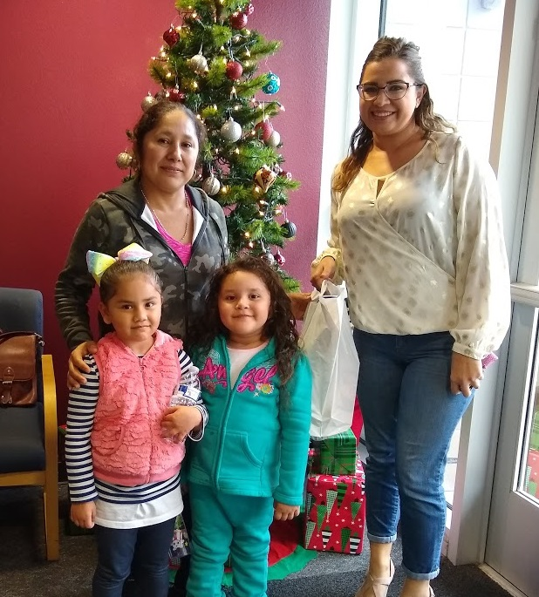
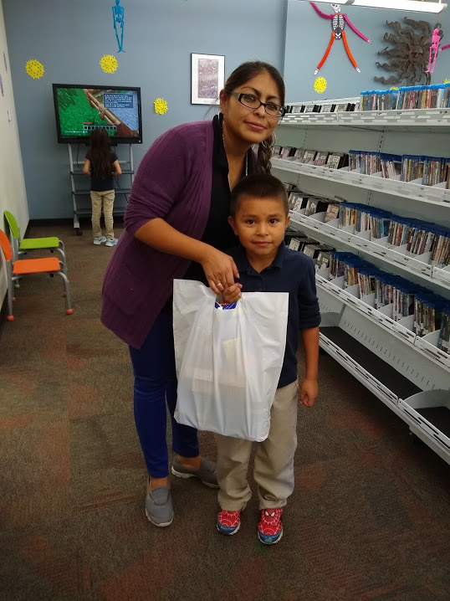
Ensuring Accessibility & Quality
Your CN Specialist will complete at least one check in visit, in person or by phone, during the program.
Please let us know if you or the families you serve have
feedback or questions at any point.
St. Mary’s Food Bank is an equal opportunity provider.
Backpacks must be accessible to eligible children
regardless of race, color, national origin, sex, age, or disability.
Let us know if you need assistance making any accommodations
Due to budgetary constraints, St. Mary’s Food Bank may not be able to provide backpacks to all families who are referred
  If your CN Specialist is not able to increase your order, they will help you start a Waiting List in case capacity becomes available.
The program is donor and/or grant funded
  SMFBA may occasionally request assistance with parent surveys to get program feedback for these funding sources

Slide 19
Corrective Action
Corrective Action may be necessary to address issues that aren’t in compliance with the program.
Any issues needing to be addressed will be communicated in writing within seven business days.
Sites must abide by the policies, procedures, and record keeping requirements of SMFBA and correct the needed deficiencies to bring site into compliance
Termination & Grievance Policy will be enacted if deficiencies are not corrected

Slide 20
Link2Feed Software (Rural Sites)
All rural sites must complete and implement Link2Feed training for prior to receiving product
Distribution numbers must be reported weekly
Distribution numbers help us –
  maintain proper ordering levels
  Avoid excess inventory
  Prevent unnecessary deliveries
If no distribution numbers are submitted weekly via Link2Feed it is assumed that no product was distributed by your site and your subsequent order will be cancelled until numbers are reported

Slide 21

Contact Us
Child Nutrition Program Specialists
  David Robinson (Northern Arizona)
  drobinson@stmarysfoodbank.org
  Cell: 480-298-0689
  Cinee Davis (Phoenix Area)
    cdavis@stmarysfoodbank.org
    Direct: 602-343-3154
Food and Nutrition Program Manager
  Terra Masias
    tlmasias@stmarysfoodbank.org
    Direct: 602-343-3124,
    Cell: 602-695-5925
    Child Nutrition Fax: 480-780-3715
    Thank you for your partnership

